Slide 1
JAVA CASE STUDY
BY KARTIKEYA…

Slide 2
AI Chatbot System (OOP in Java)
ENCAPSULATION
INHERITANCE
POLYMORPHISM
ABSTRACTION

Slide 3
import java.util.Scanner;
// Abstraction using an interface
interface Conversational {
String respond(String message);
}
// Base class (Encapsulation)
abstract class ChatBot implements Conversational {
protected String botName;
public ChatBot(String name) {
this.botName = name;
}
public abstract String respond(String message);
}

Slide 4
// Inherited class for Formal Chatbot
class FormalBot extends ChatBot {
public FormalBot(String name) {
super(name);
}
@Override
public String respond(String message) {
return "Hello. I appreciate your message: '" + message + “’
. How may I assist you today?";
}
}
// Inherited class for Casual Chatbot
class CasualBot extends ChatBot {
public CasualBot(String name) {
super(name);
}
@Override

Slide 5
public String respond(String message) {
return "Hey! You said: '" + message + "'. What's up?";
}
}
// Inherited class for Sarcastic Chatbot
class SarcasticBot extends ChatBot {
public SarcasticBot(String name) {
super(name);
}
@Override
public String respond(String message) {
return "Oh wow, '" + message + "'... such an original thought!";
}
}

Slide 6
// Main Class
public class ChatBotSystem {
public static void main(String[] args) {
Scanner scanner = new Scanner(System.in);
// Choosing bot personality
System.out.println("Choose your chatbot:
1. Formal 2. Casual 3. Sarcastic");
int choice = scanner.nextInt();
scanner.nextLine(); // Consume newline

Slide 7
ChatBot bot;
if (choice == 1) {
bot = new FormalBot(“JAI");
} else if (choice == 2) {
bot = new CasualBot(“VIKRAM");
} else {
bot = new SarcasticBot(“BUJJI");
}
System.out.println("Start chatting! Type 'exit' to stop.");
while (true) {
System.out.print("You: ");
String userInput = scanner.nextLine();

Slide 8
if (userInput.equalsIgnoreCase("exit")) {
System.out.println(bot.botName + ": Goodbye!");
break;
}
System.out.println(bot.botName + ": " + bot.respond(userInput));
}
scanner.close();
}
}

Slide 9
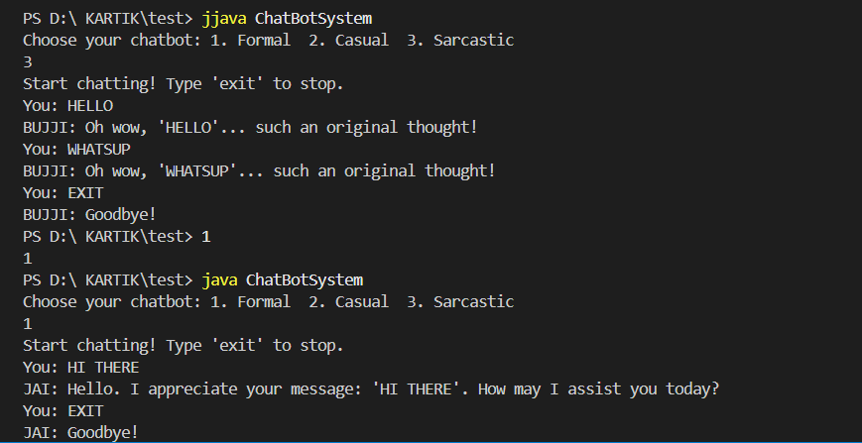
SAMPLE OUTPUT

Slide 10
2023001492
KARTIKEYA…

Slide 11
Thanks!
CLICK HERE FOR CODE

